Slide 1
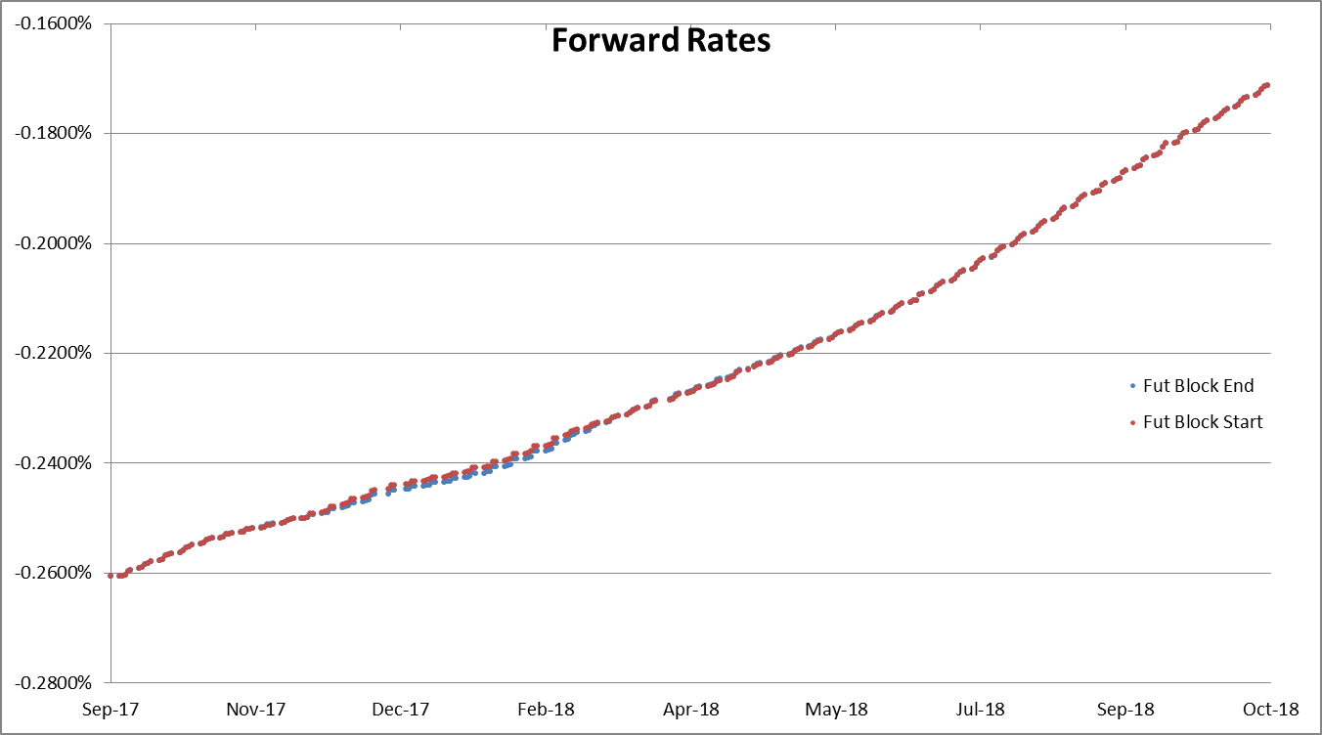
24 Nov 2016 – 3M Rates

Slide 2
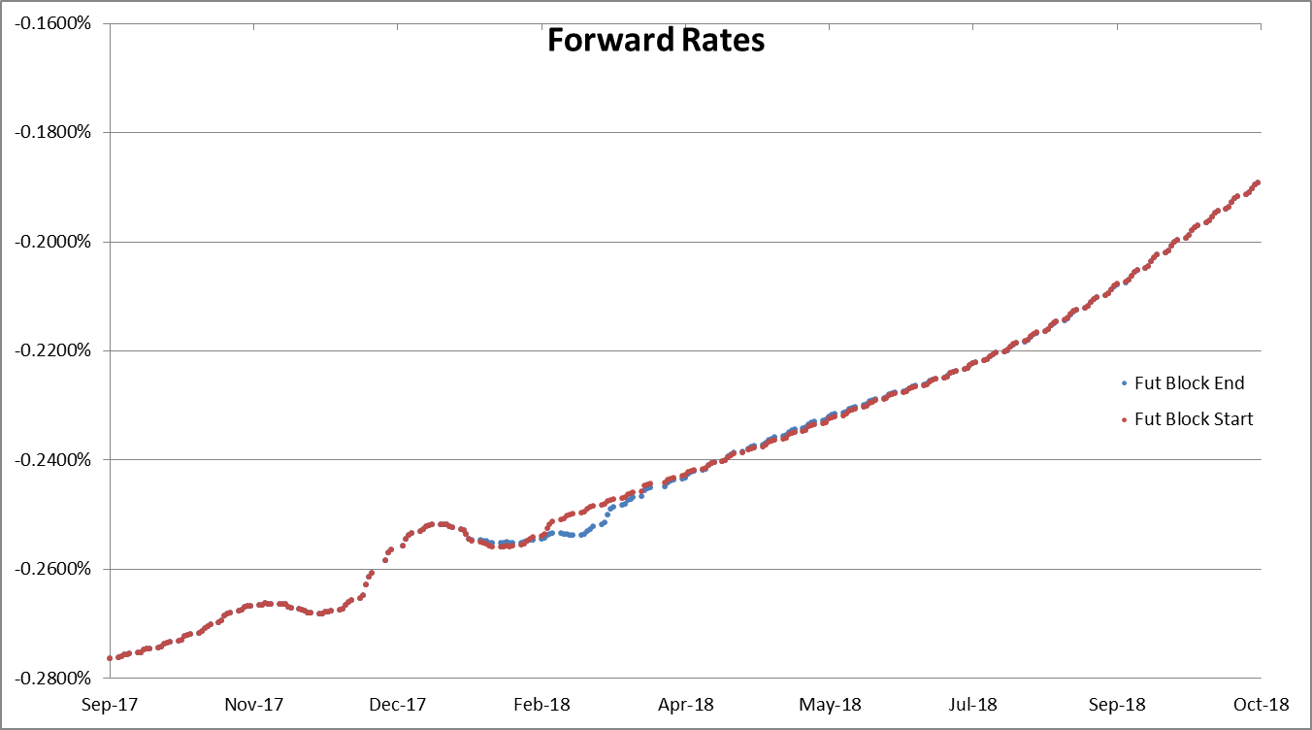
24 Nov 2016 – Inst Rates

Slide 3
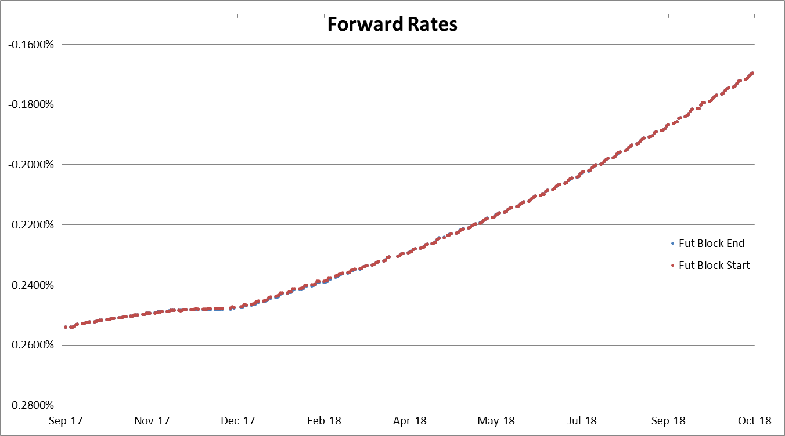
1 Dec 2016 – 3M Rates

Slide 4
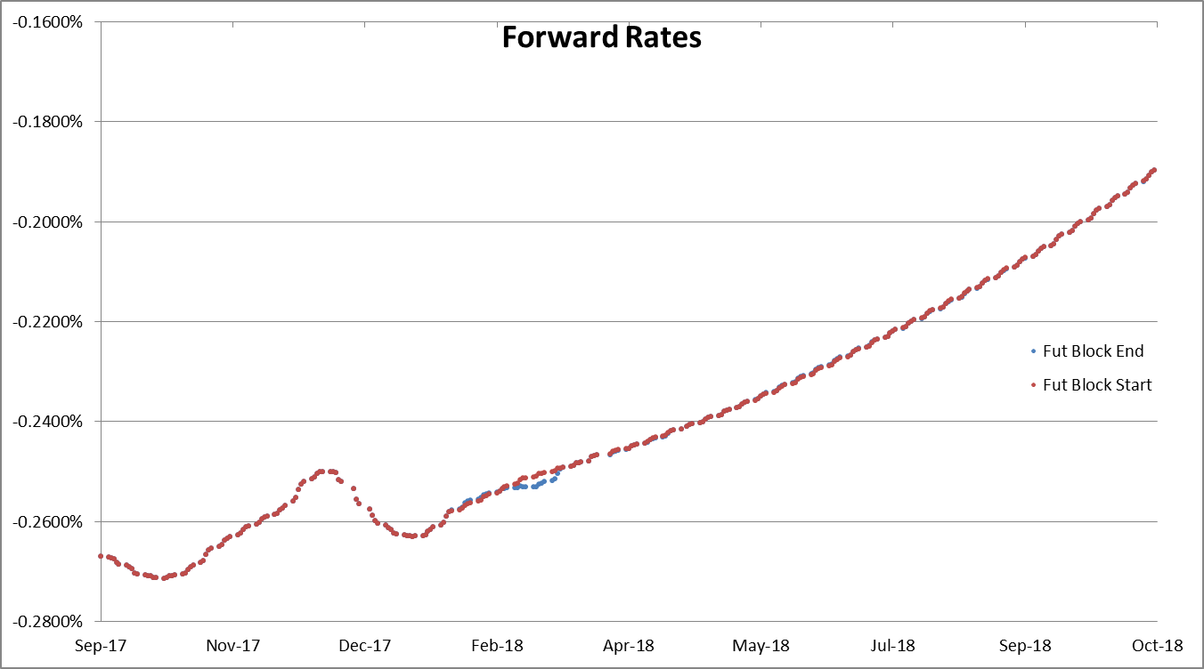
1 Dec 2016 – Inst Rates

Slide 5
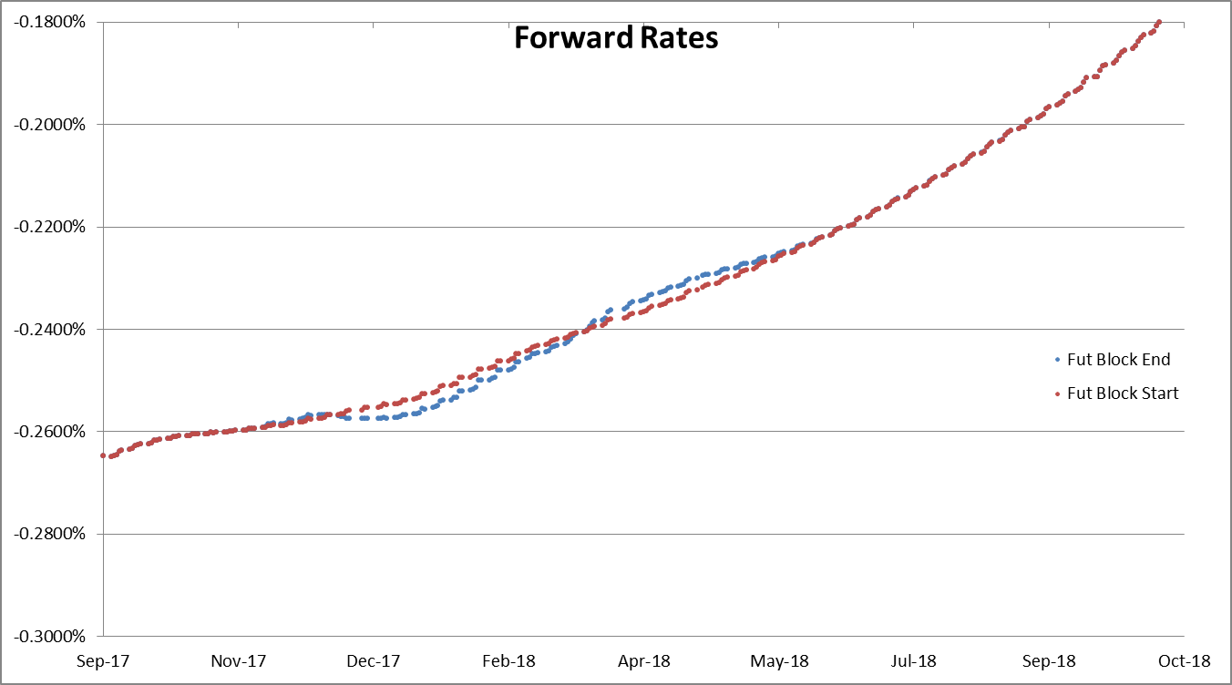
15 Dec 2016 – 3M Rates

Slide 6
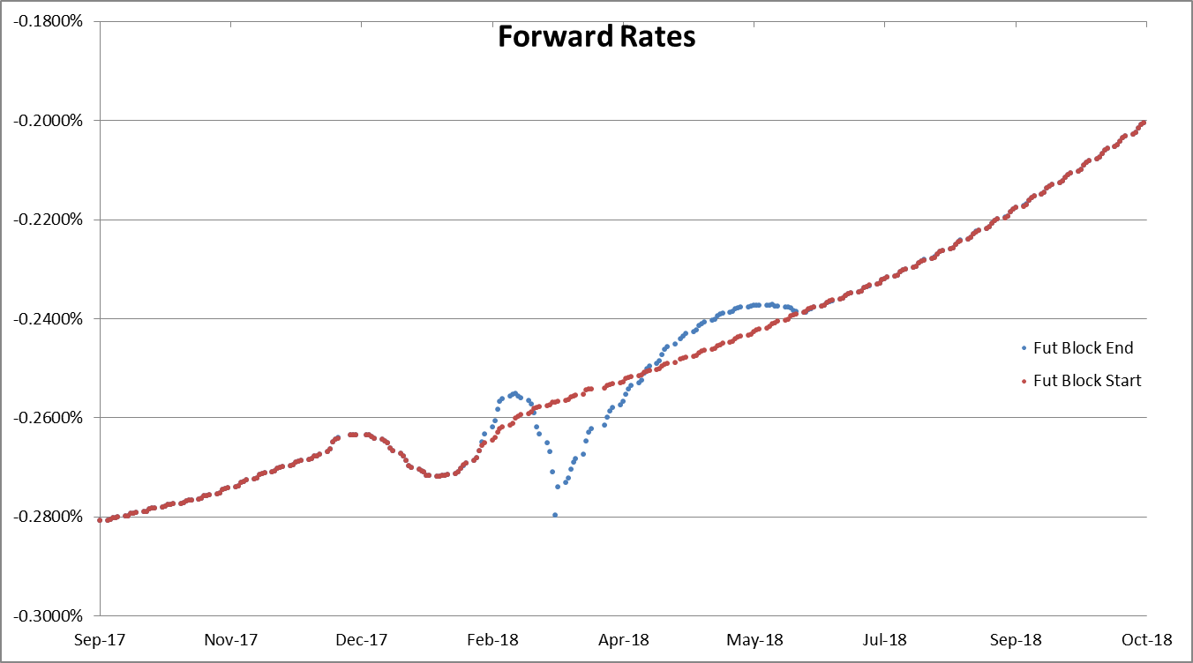
15 Dec 2016 – Inst Rates

Slide 7
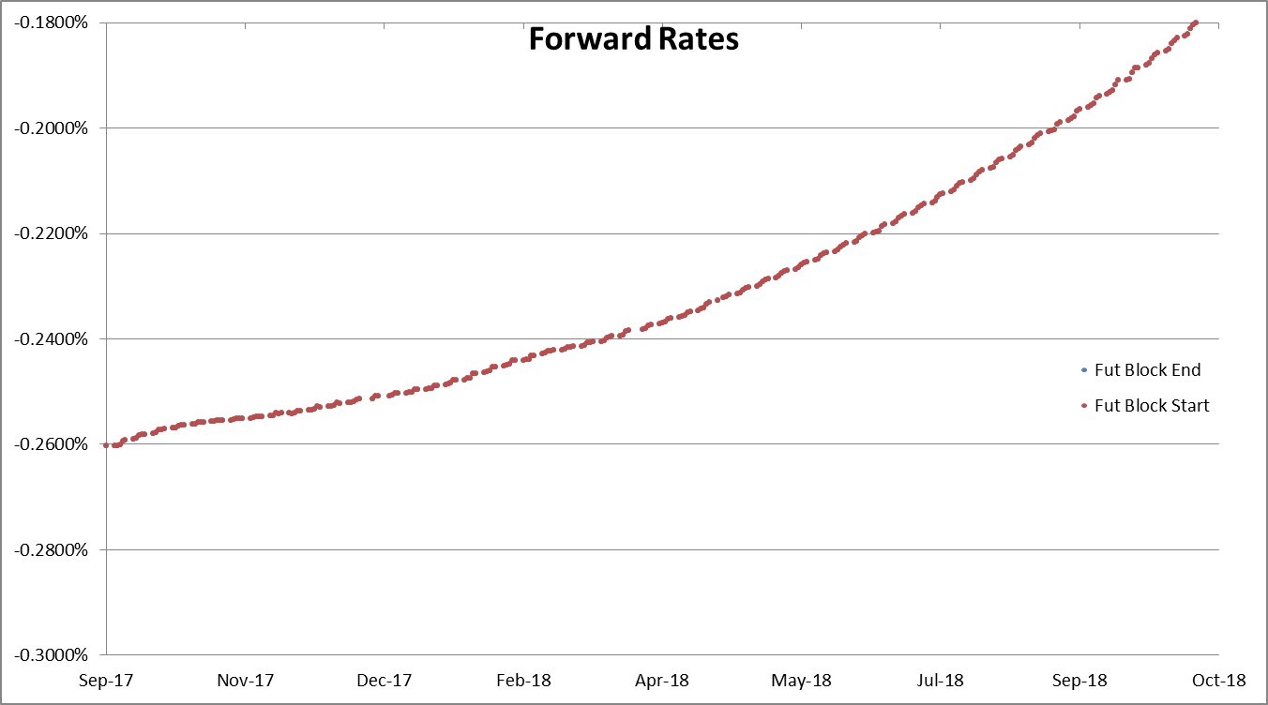
16 Dec 2016 – 3M Rates
Idem 19 Dec 2016

Slide 8
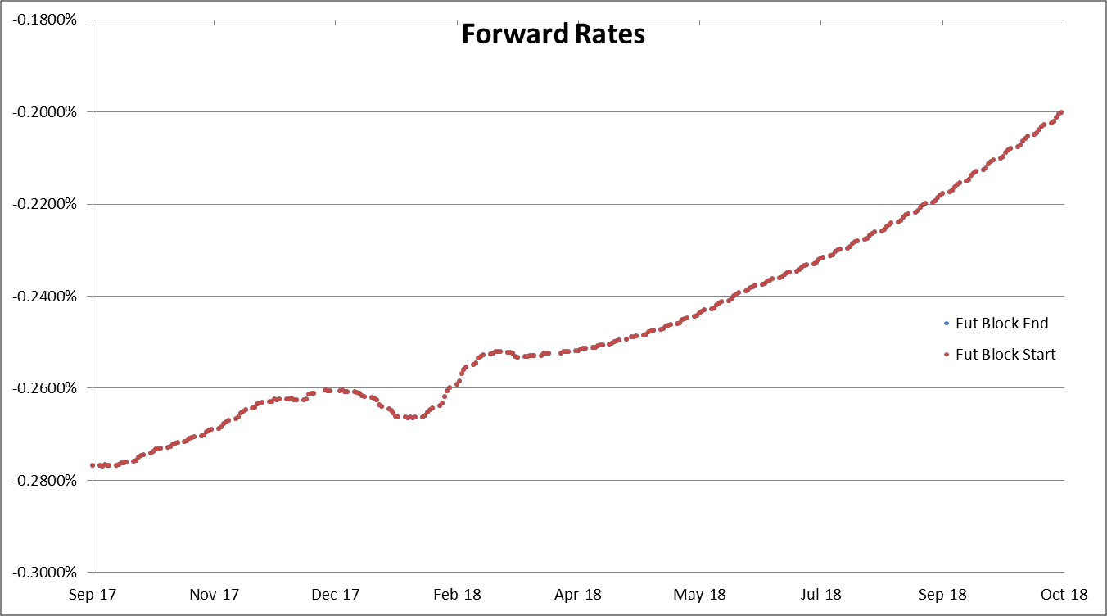
16 Dec 2016 – Inst Rates
Idem 19 Dec 2016

Slide 9
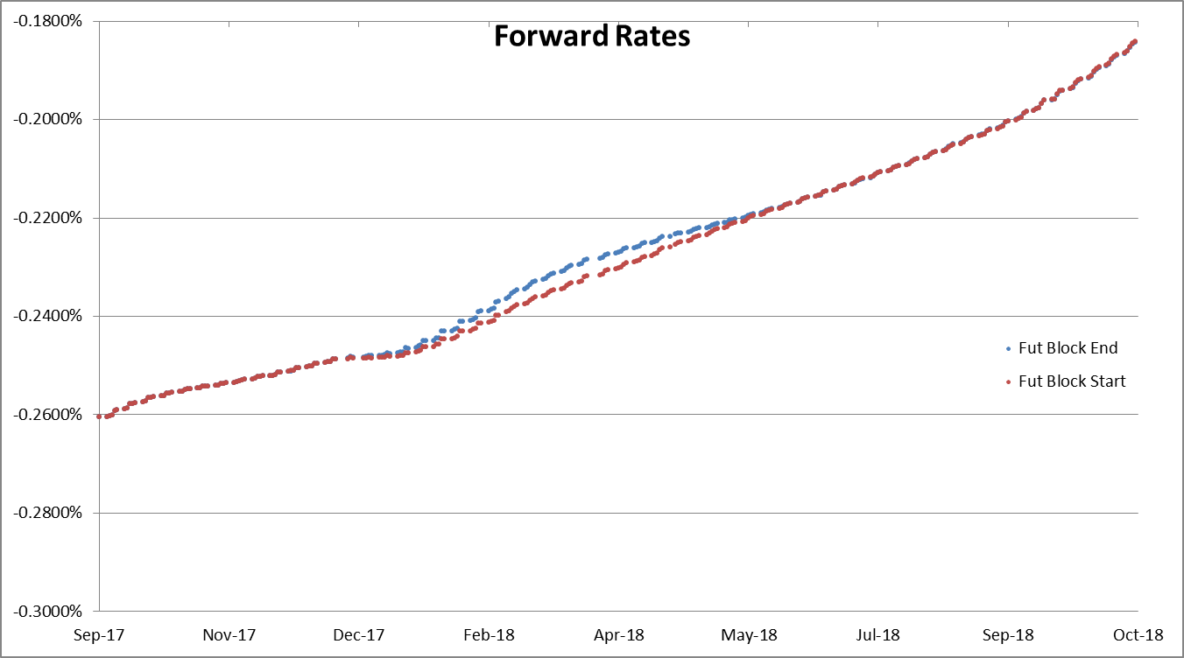
20 Dec 2016 – 3M Rates

Slide 10
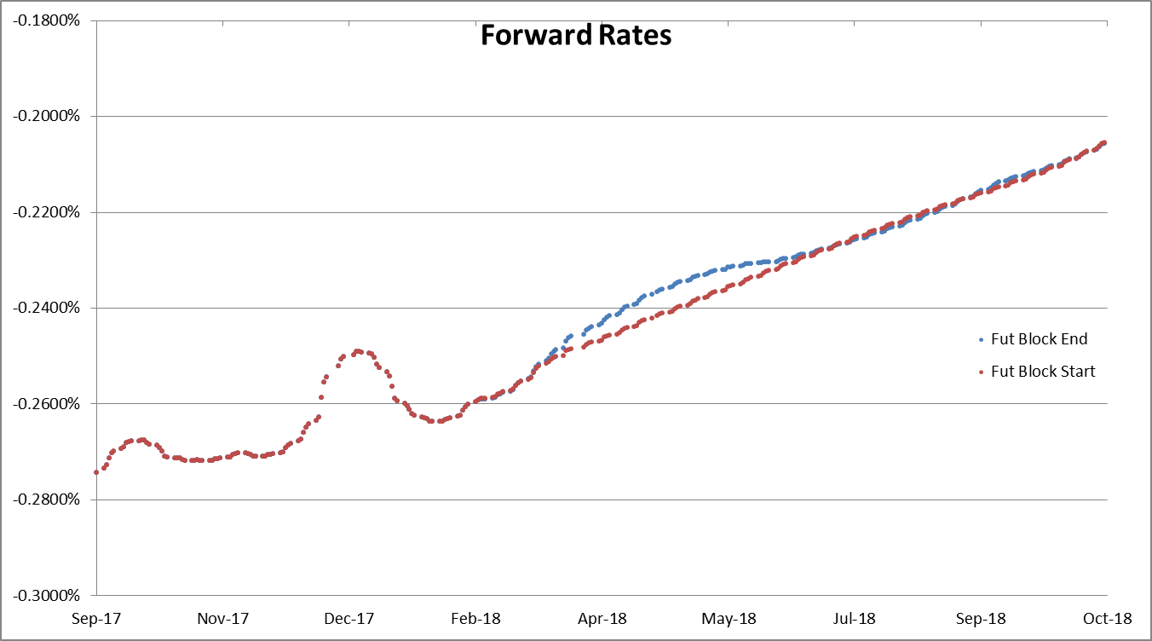
20 Dec 2016 – Inst Rates

Slide 11
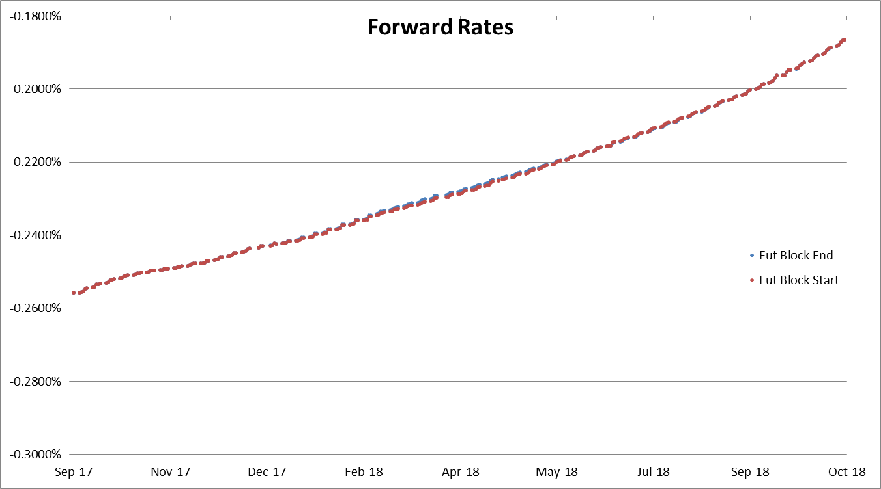
21 Dec 2016 – 3M Rates

Slide 12
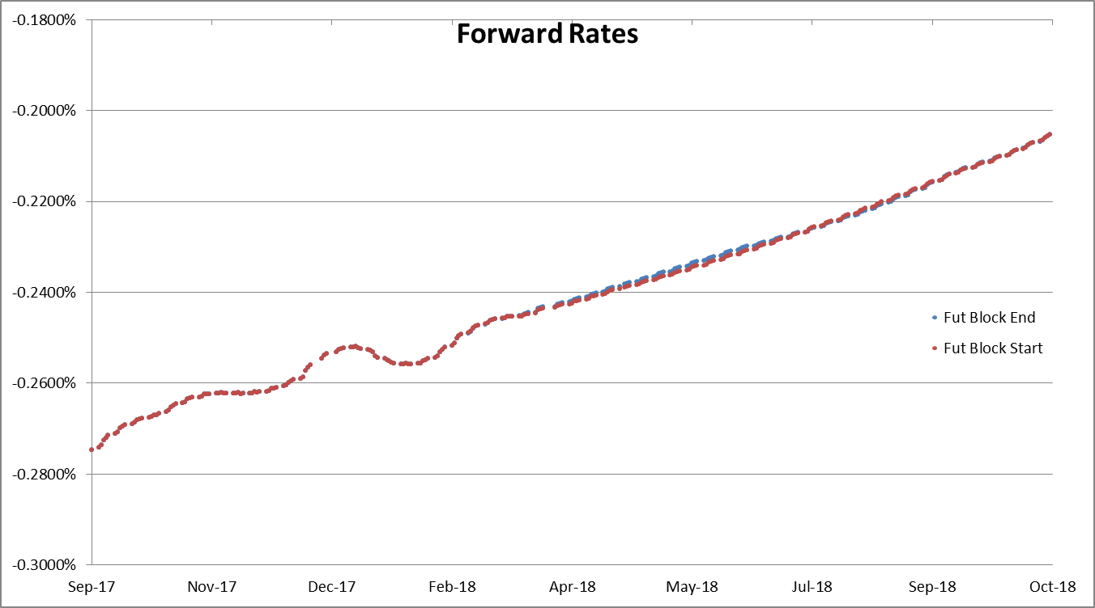
21 Dec 2016 – Inst Rates

Slide 13
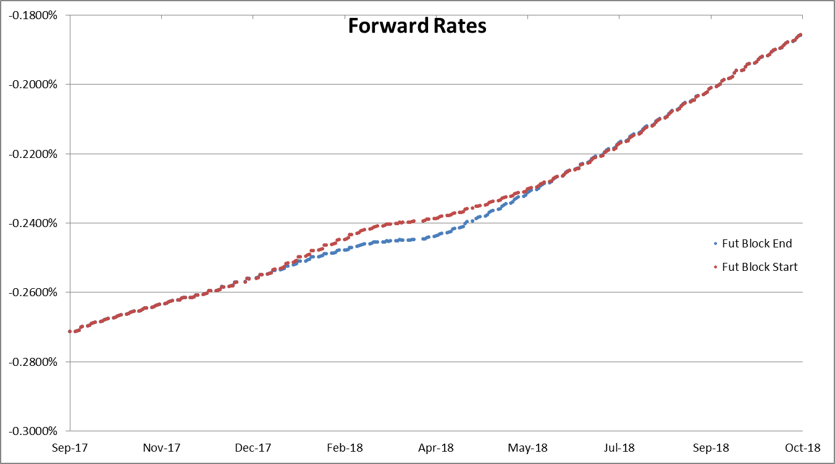
5 Jan 2017 – 3M Rates

Slide 14
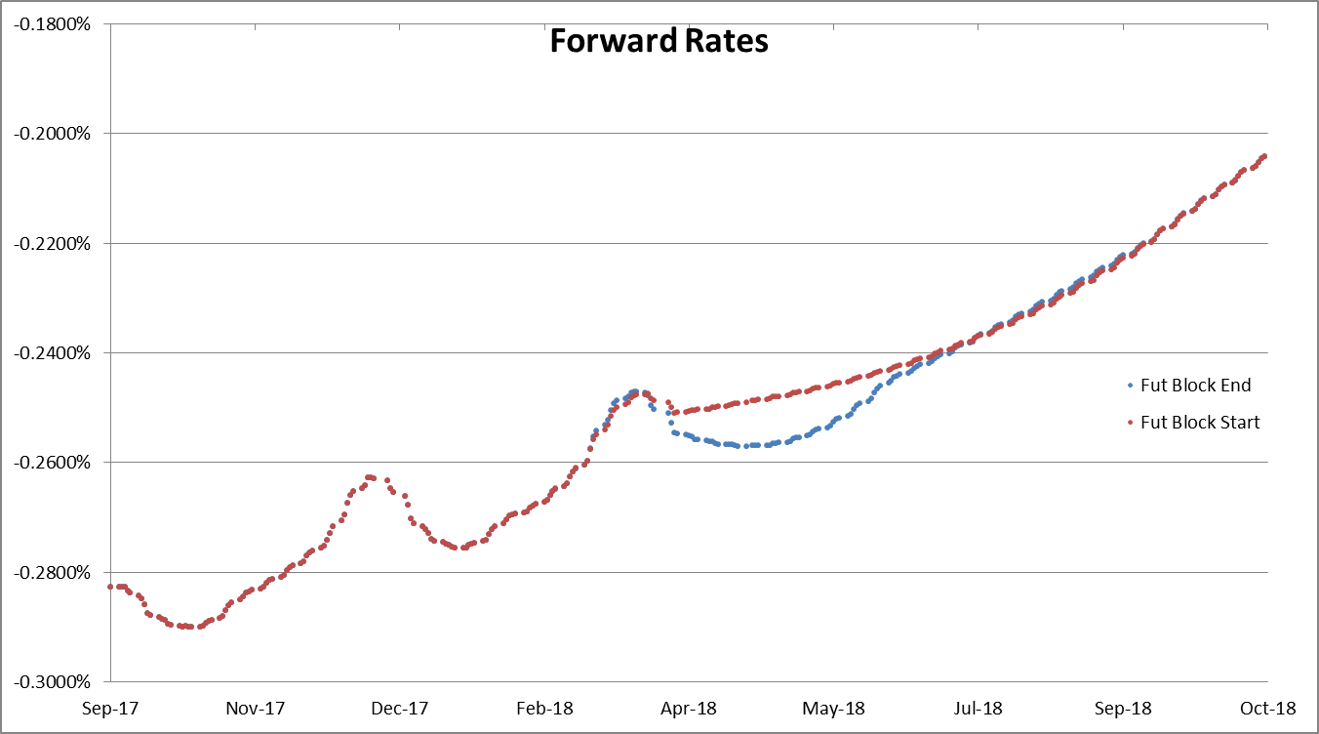
5 Jan 2017 – Inst Rates

